Slide 1
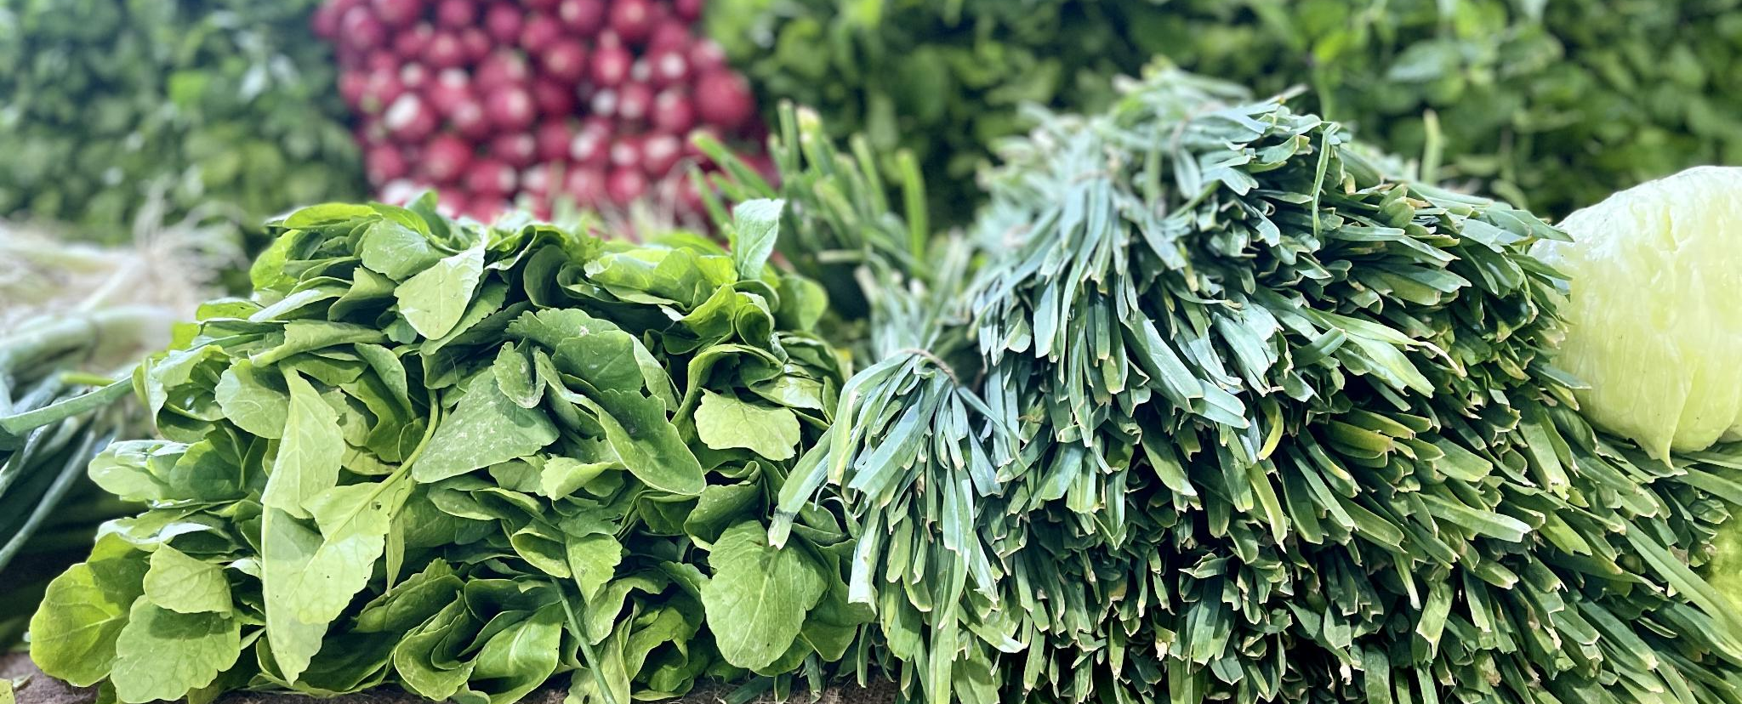
Local Market Price Tracker for Agricultural Commodities in Uganda
Monitoring price trends to support farmers and traders
Notes:
---

Slide 2
Project Overview
Notes:
---
This slide references information from the following file: https://bayloruganda22-my.sharepoint.com/personal/jmopaman_baylor-uganda_org/_layouts/15/Doc.aspx?sourcedoc=%7BD3163637-F9C4-4D01-9DF1-341E9EA1EA73%7D&file=Opaman_Micaiah_Joshua_OOP_Final%20Examination%20Project%20Proposal.docx&action=default&mobileredirect=true
Title & Student Info, Problem Statement, Objectives, Real-World Relevance, Scope of Work, Tools & Technologies, System Design (OOP approach), Key Features, Expected Outcomes, Future Enhancements & Conclusion

Slide 3

Title & Student Info
Project Overview
  The project tracks agricultural commodity prices to help farmers and traders access reliable market data.
Student Information
  Developed by Opaman Micaiah Joshua for an Object-Oriented Programming with Python course.
Technical Approach
  Uses Python's object-oriented programming concepts to build a robust and accessible tool.
Notes:
---
This slide references information from the following file: https://bayloruganda22-my.sharepoint.com/personal/jmopaman_baylor-uganda_org/_layouts/15/Doc.aspx?sourcedoc=%7BD3163637-F9C4-4D01-9DF1-341E9EA1EA73%7D&file=Opaman_Micaiah_Joshua_OOP_Final%20Examination%20Project%20Proposal.docx&action=default&mobileredirect=true
This presentation introduces the final examination project titled 'Local Market Price Tracker for Agricultural Commodities in Uganda' developed by Opaman Micaiah Joshua. The project is part of the Object-Oriented Programming with Python course and aims to address the challenges faced by smallholder farmers and traders in accessing reliable market price data. The student details include Registration Number S25M19/038 and Access Number B35677. The project leverages Python's object-oriented capabilities to build a robust and accessible tool for tracking agricultural commodity prices.

Slide 4
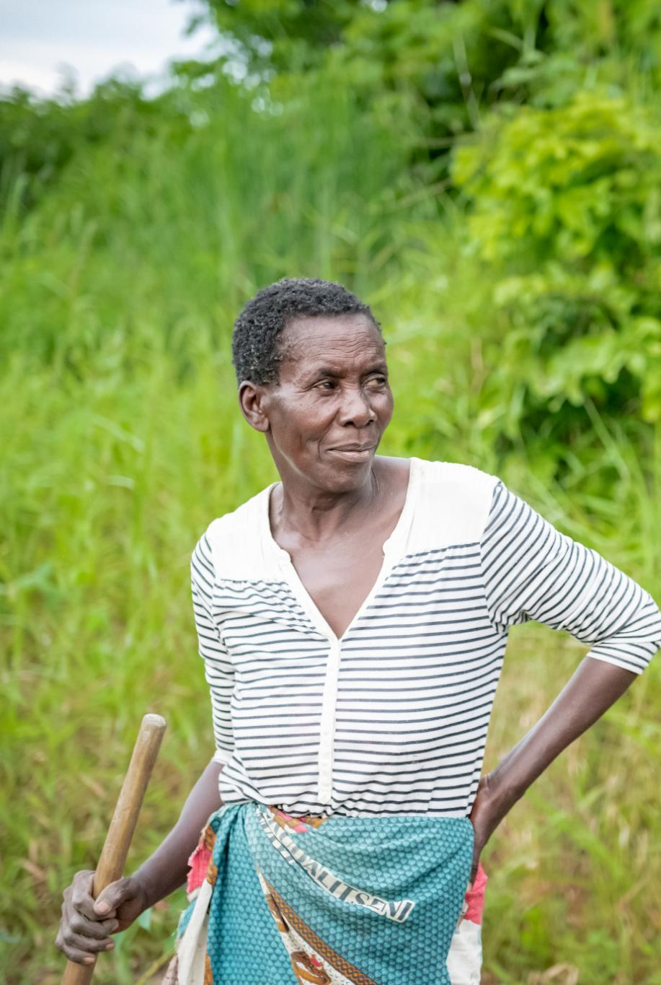
Problem Statement
Market Data Access Issues
  Smallholder farmers and traders in Uganda lack reliable access to consistent market price data for staple crops.
Impact on Income and Planning
  Lack of price data leads to undervalued sales and difficulty planning for purchases and sales among traders.
Limitations of Existing Platforms
  Current platforms are often internet-dependent, costly, or not designed to meet local needs in rural Uganda.
Project Goal
  Develop an offline-capable, simple tool for tracking and analyzing price trends to support farmers and traders.
Notes:
---
This slide references information from the following file: https://bayloruganda22-my.sharepoint.com/personal/jmopaman_baylor-uganda_org/_layouts/15/Doc.aspx?sourcedoc=%7BD3163637-F9C4-4D01-9DF1-341E9EA1EA73%7D&file=Opaman_Micaiah_Joshua_OOP_Final%20Examination%20Project%20Proposal.docx&action=default&mobileredirect=true
In Uganda, smallholder farmers and local traders often lack access to consistent and reliable market price data for staple crops such as maize, beans, matoke, and groundnuts. This results in farmers selling produce at undervalued rates and traders struggling with planning purchases and sales. Existing platforms are often internet-dependent, expensive, or not tailored to local needs. The absence of centralized and accessible price data contributes to income instability and weakens the bargaining power of rural producers. This project seeks to address these issues by developing a simple, offline-capable tool for tracking and analyzing price trends.

Slide 5
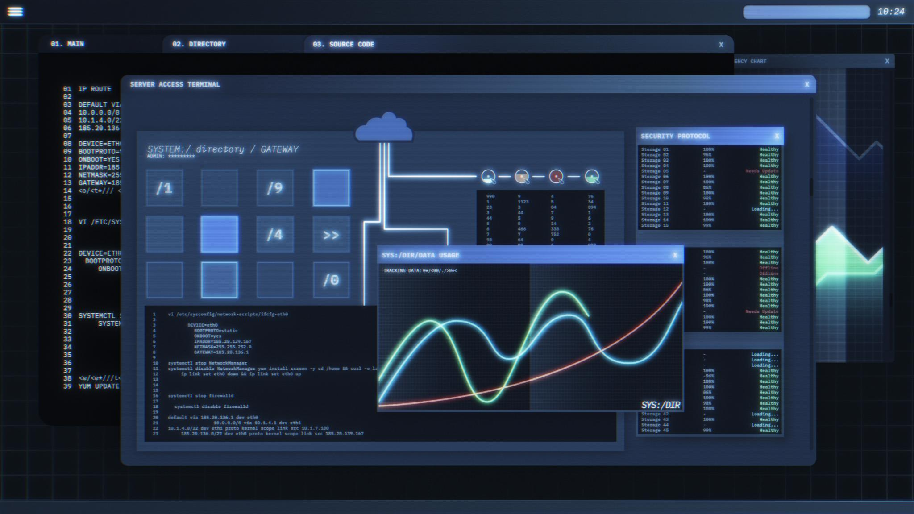
Objectives
Modular Python Application
  Design a modular, object-oriented Python app for recording and storing agricultural market prices.
Data Storage with SQLite
  Implement a SQLite-backed system to enable reliable local storage suitable for low internet access areas.
Trend Visualization
  Generate clear, informative market price trend visualizations using Matplotlib to assist decision-making.
User Empowerment
  Provide reusable code, sample data, and documentation to empower users with data-driven insights.
Notes:
---
This slide references information from the following file: https://bayloruganda22-my.sharepoint.com/personal/jmopaman_baylor-uganda_org/_layouts/15/Doc.aspx?sourcedoc=%7BD3163637-F9C4-4D01-9DF1-341E9EA1EA73%7D&file=Opaman_Micaiah_Joshua_OOP_Final%20Examination%20Project%20Proposal.docx&action=default&mobileredirect=true
The primary objectives of the project are to design a modular object-oriented Python application that enables users to record, store, and visualize daily market prices for agricultural products. The application aims to be simple and accessible, suitable for use by farmers, cooperatives, and local traders even in areas with limited internet access. Specific goals include implementing a SQLite-backed storage system, generating trend visualizations using Matplotlib, and providing a reusable codebase with sample data and documentation. These objectives align with the broader goal of empowering users with data-driven insights to improve decision-making and promote fair trade practices.

Slide 6

Real-World Relevance
Agriculture Workforce in Uganda
  Over 70% of Uganda’s workforce is employed in agriculture, highlighting the sector’s importance.
Offline Price Tracker Tool
  A lightweight, user-friendly price tracker operates offline to assist farmers with market analysis.
Empowering Farmers and Traders
  The tool provides actionable insights enabling informed decisions and reducing exploitation risks.
Future Scalability Features
  Plans include SMS input, radio integration, and syncing with national databases for broader impact.
Notes:
---
This slide references information from the following file: https://bayloruganda22-my.sharepoint.com/personal/jmopaman_baylor-uganda_org/_layouts/15/Doc.aspx?sourcedoc=%7BD3163637-F9C4-4D01-9DF1-341E9EA1EA73%7D&file=Opaman_Micaiah_Joshua_OOP_Final%20Examination%20Project%20Proposal.docx&action=default&mobileredirect=true
Agriculture employs over 70% of Uganda’s workforce, yet digital tools for market analysis are rarely available at the grassroots level. This project addresses a critical gap by providing a lightweight and user-friendly price tracker that works offline. The tool empowers farmers and traders with actionable insights, helping them make informed decisions and avoid exploitation. It also lays the groundwork for future enhancements such as SMS-based input, integration with local radio broadcasts, and syncing with national market databases. These features make the tool scalable and adaptable to broader contexts, enhancing its real-world applicability.

Slide 7

Scope of Work
Application Features
  Develop a Python app with data entry, local storage, trend analysis, and product management features.
Command-Line Interface
  Use a CLI design for ease of use and compatibility with low-resource environments.
Data Visualization
  Generate visual graphs to analyze pricing trends and optional market comparisons.
Project Documentation
  Create sample datasets, visual outputs, and document system architecture clearly.
Notes:
---
This slide references information from the following file: https://bayloruganda22-my.sharepoint.com/personal/jmopaman_baylor-uganda_org/_layouts/15/Doc.aspx?sourcedoc=%7BD3163637-F9C4-4D01-9DF1-341E9EA1EA73%7D&file=Opaman_Micaiah_Joshua_OOP_Final%20Examination%20Project%20Proposal.docx&action=default&mobileredirect=true
The scope of the project includes developing a Python application with core features such as data entry for daily prices, local data storage using SQLite, trend analysis through visual graphs, product management capabilities, and optional market comparison features. The application is designed to be operated via a command-line interface (CLI), ensuring ease of use and compatibility with low-resource environments. The project also involves generating sample datasets, creating visual outputs, and documenting the system architecture. These components collectively demonstrate the practical application of object-oriented programming principles in solving real-world problems.

Slide 8

Tools & Technologies
Core Programming Language
  Python 3.13 serves as the main language, known for its versatility and robust ecosystem.
Data Handling Libraries
  Pandas manages data efficiently while Matplotlib enables visualization of price trends.
File and Database Support
  Openpyxl supports Excel files, and sqlite3 handles local database storage for offline data management.
User Interface and Reporting
  A command-line interface enables user interaction, while python-docx and python-pptx generate reports and slides automatically.
Notes:
---
This slide references information from the following file: https://bayloruganda22-my.sharepoint.com/personal/jmopaman_baylor-uganda_org/_layouts/15/Doc.aspx?sourcedoc=%7BD3163637-F9C4-4D01-9DF1-341E9EA1EA73%7D&file=Opaman_Micaiah_Joshua_OOP_Final%20Examination%20Project%20Proposal.docx&action=default&mobileredirect=true
The project utilizes Python 3.13 as the primary programming language, with several libraries to support its functionality. Pandas is used for data manipulation, Matplotlib for plotting price trends, datetime for handling dates, openpyxl for Excel file support, and sqlite3 for local database storage. The application features a command-line interface (CLI) for user interaction. Additionally, python-docx and python-pptx are employed to generate the project report and presentation slides. These tools and technologies are chosen for their robustness, ease of use, and suitability for offline environments.

Slide 9
System Design (OOP approach)
Class | Purpose | Key Methods
Product | Represents a tracked agricultural product | name
Market | Represents a market location | name, location
PriceRecord | Stores price data for a product-market-date | product, market, price, date
DatabaseManager | Handles SQLite operations | add_product, add_market, record_price, fetch_timeseries
Plotter | Generates trend plots | plot_product_trend
Notes:
---
This slide references information from the following file: https://bayloruganda22-my.sharepoint.com/personal/jmopaman_baylor-uganda_org/_layouts/15/Doc.aspx?sourcedoc=%7BD3163637-F9C4-4D01-9DF1-341E9EA1EA73%7D&file=Opaman_Micaiah_Joshua_OOP_Final%20Examination%20Project%20Proposal.docx&action=default&mobileredirect=true
The system is designed using object-oriented programming principles, featuring classes such as Product, Market, PriceRecord, DatabaseManager, and Plotter. The Product, Market, and PriceRecord classes serve as lightweight data models. The DatabaseManager class encapsulates the SQLite schema, CRUD operations, and time-series queries, while the Plotter class handles data visualization using Pandas and Matplotlib. This modular design ensures code reusability, maintainability, and scalability. A system architecture diagram illustrates the interactions between these components, highlighting the flow of data and the generation of visual outputs.

Slide 10
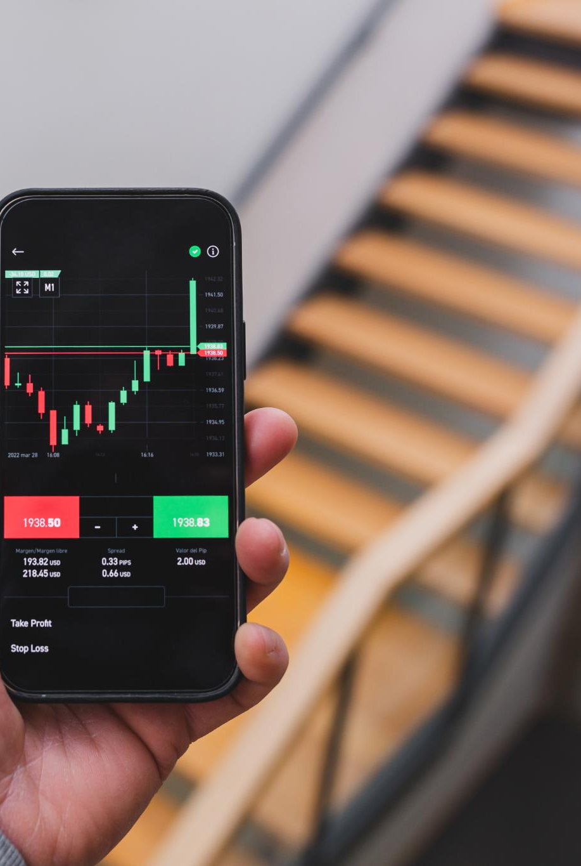
Key Features
Product and Market Management
  Users can easily add and manage products and markets to personalize their data tracking experience.
Price Recording and Visualization
  The app records daily prices and generates trend visualizations to help analyze market movements effectively.
Offline Data Storage
  Data is stored locally using SQLite, ensuring users can access the app and data without internet connection.
Market Comparison
  Supports comparison of price variations for individual products across different markets for better decision making.
Notes:
---
This slide references information from the following file: https://bayloruganda22-my.sharepoint.com/personal/jmopaman_baylor-uganda_org/_layouts/15/Doc.aspx?sourcedoc=%7BD3163637-F9C4-4D01-9DF1-341E9EA1EA73%7D&file=Opaman_Micaiah_Joshua_OOP_Final%20Examination%20Project%20Proposal.docx&action=default&mobileredirect=true
The application includes several key features designed to enhance usability and functionality. Users can add products and markets, record daily prices, and generate trend visualizations. The data is stored locally using SQLite, ensuring offline accessibility. The application also supports market comparison for individual products, allowing users to analyze price variations across different locations. Screenshots of sample charts for commodities like maize and beans demonstrate the tool’s capabilities. These features collectively provide a comprehensive solution for tracking and analyzing agricultural market prices.

Slide 11
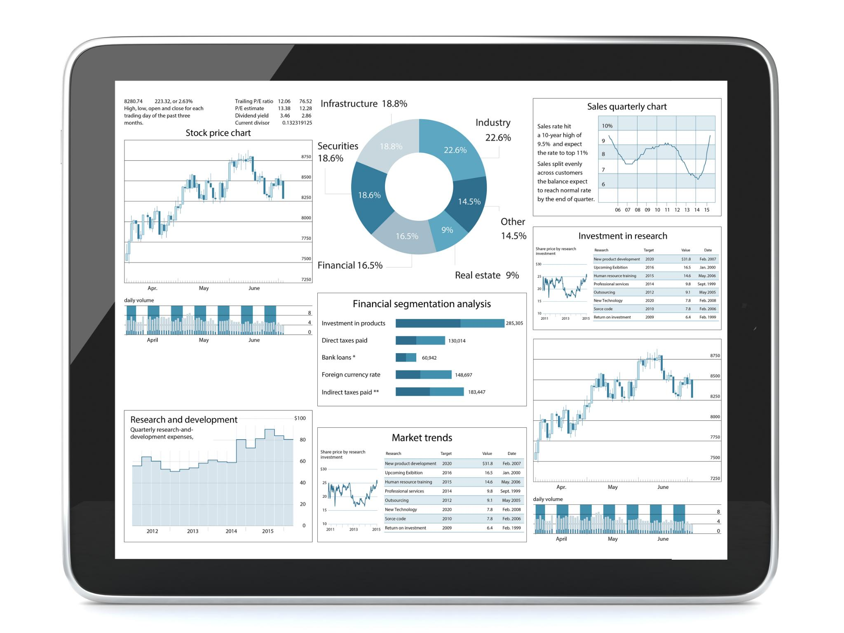
Expected Outcomes
Functional Python Application
  The project produces a Python app that tracks and visualizes agricultural commodity prices effectively.
Object-Oriented Design and Data Persistence
  The application uses object-oriented principles and SQLite for local data storage and management.
Trend Visualization for Decision Making
  Trend charts display short-term fluctuations and weekly patterns to support informed decisions.
Modular Codebase and Project Resources
  Modular, reusable code enables future features; includes sample datasets, documentation, and GitHub repo.
Notes:
---
This slide references information from the following file: https://bayloruganda22-my.sharepoint.com/personal/jmopaman_baylor-uganda_org/_layouts/15/Doc.aspx?sourcedoc=%7BD3163637-F9C4-4D01-9DF1-341E9EA1EA73%7D&file=Opaman_Micaiah_Joshua_OOP_Final%20Examination%20Project%20Proposal.docx&action=default&mobileredirect=true
The expected outcomes of the project include a fully functional Python application that tracks and visualizes market prices for agricultural commodities. The application demonstrates object-oriented design and local data persistence using SQLite. It provides trend charts that reveal short-term fluctuations and weekly patterns, aiding in decision-making. The codebase is modular and reusable, making it suitable for future enhancements such as GUI integration or SMS-based input. The project also includes sample datasets, documentation, and a GitHub repository, ensuring ease of use and accessibility for end users.

Slide 12
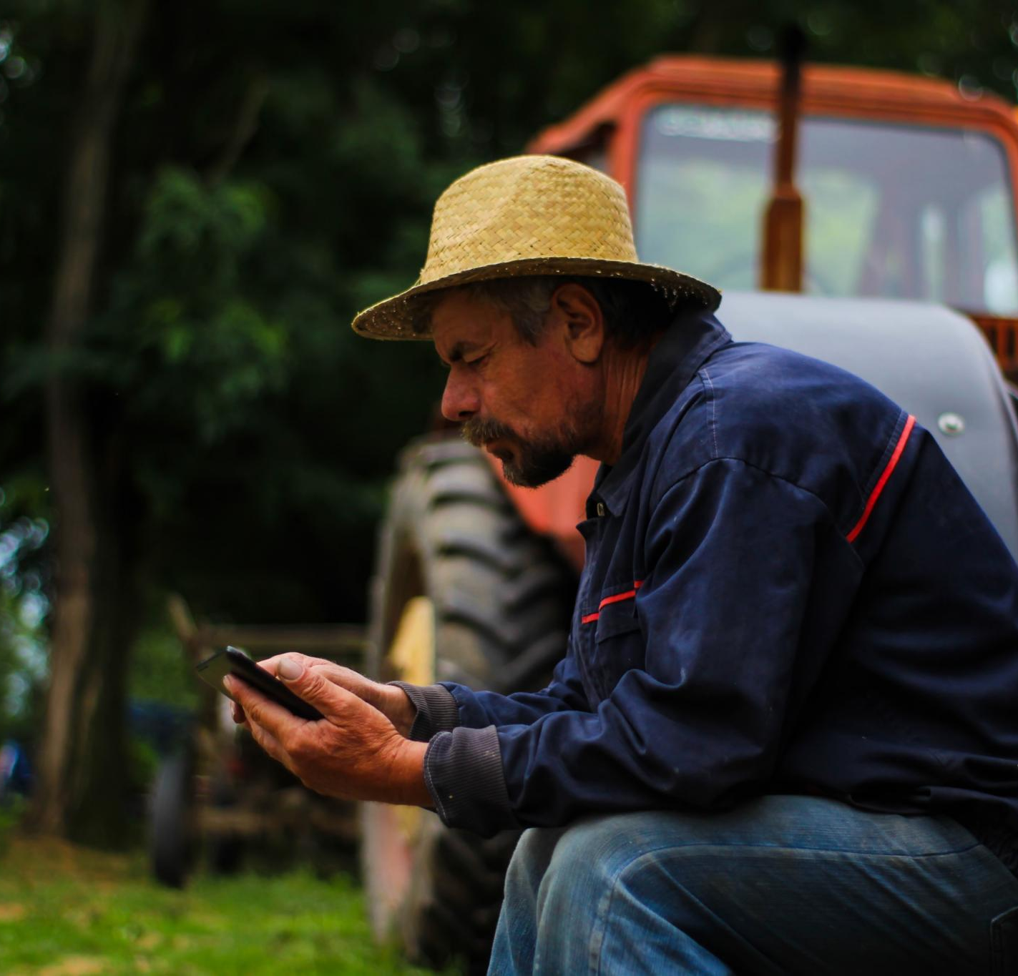
Future Enhancements & Conclusion
Future Feature Enhancements
  Upcoming features include CSV/Excel support, scheduled data entry, cooperative user roles, and SMS/USSD input for low-end phones.
Integration and Alerting
  Plans include API integration with national datasets and alert features like price thresholds and anomaly detection.
Project Conclusion
  The project applies object-oriented programming to create an offline solution that tracks market prices and promotes fair trade.
Notes:
---
This slide references information from the following file: https://bayloruganda22-my.sharepoint.com/personal/jmopaman_baylor-uganda_org/_layouts/15/Doc.aspx?sourcedoc=%7BD3163637-F9C4-4D01-9DF1-341E9EA1EA73%7D&file=Opaman_Micaiah_Joshua_OOP_Final%20Examination%20Project%20Proposal.docx&action=default&mobileredirect=true
Future enhancements for the application include support for CSV and Excel import/export, scheduled data entry, user roles and authentication for cooperatives, SMS/USSD input for low-end phones, and API integration with national market datasets. Alerting features such as price thresholds and anomaly detection are also planned. In conclusion, the project successfully demonstrates the application of object-oriented programming principles in solving a real-world problem. It provides a practical, offline-capable solution for tracking agricultural market prices, empowering users with data-driven insights and promoting fair trade practices.

